Slide 1


PAO-BU-LIAO
A Smart Contract-based Management System for
Advance Receipts and Accounts Receivable.
18th April, 2025
Group Members: Kai Ren, YiMing Jiang, WeiJie Zhang, Rui Hu, Yang Lan
Notes:
Good evening, professor and classmates. We are Group 2, and I am RenKai.
It’s a great honor to share our group’s project with you.
In this project, we conceptualized and developed a smart contract application, which we called Paobuliao.
It is a smart contract-based management system for advance receipts and accounts receivable.

Slide 2

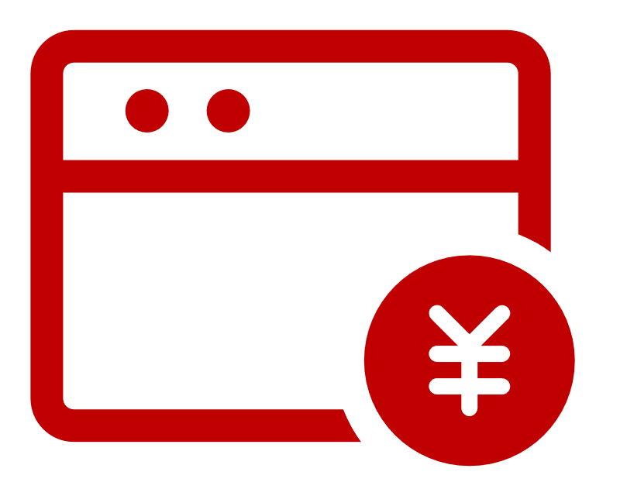





I. Introduction: Motivation
Pay First, Use Later: Advance Receipts
Use First, Pay Later: Accounts Receivable
Cash First
Welfare
Willingness
Service First
Buyer
Recharge Cash
Seller
Buyer
Try Service
Seller
Service Later
Cash Later
Seller Promise: Feel free to recharge, I won't run away!
Buyer Promise: Try a few more times, I won't run away!
Based on the TRUST between the Buyer and Seller. It’s NOT sturdy!
Seller True Thought:
Feel free to recharge, I'll run if I can't serve you!
Buyer True Thought:
Try a few more times, I will run and spend nothing.
Have you ever experienced a seller RUNNING out of business after charging a card?
Gym, Barbershop, Coffee Shop …
It had happened in the Coffee Shop of STL! 100 students, nearly 10,000 RMB, 1 Year!
Notes:
First, we want to share with you the motivation for our project.
In real life, we always see “pay first and use later” and “use first and pay later” business models where there is a time lag between cash flow and service.
This is based on the trust between the buyer and seller of the service, it is not sturdy !
We can do a survey, Have you ever experienced a seller RUNNING out of business after charging a card?
Gym, Barbershop, Coffee Shop …
It had happened in the Coffee Shop of STL! 100 students, nearly 10,000 RMB!

Slide 3


I. Introduction: Motivation
Fig 1.1 Statistics on Prepaid GYM Run Away.
Fig 1.2 Statistics on Prepaid Coffee & Milk Tea Shop Run Away.
Runaways Happen All the Time!
The recovery rate of arrears averaged less than 20 per cent.
It appears to be poor cash flow management.
The essence is that Money is Untraceable and can be used in any way.
Pooling out of control
“unregulated misappropriation” of advances
Legal and regulatory loopholes
low cost of violating the law
Business strategy: maliciously designed “harvest traps”
Is there a way to accurately TRACK Services and Cash Flow so that it PAO-BU-LIAO? Smart Contract!
Data Source: China Consumers' Association, Referee Websites
Notes:
数据也表明，目前预付账款和应收账款的管理情况很差。
容易追回我们的钱呢？让他跑不了！

Slide 4
I. Introduction: Framework
Ⅱ. Bussiness Architecture
1. Verification
2. Establishment
3. Consumption
4. Termination
Ⅲ. Technological Implementation
Why we must use Smart Contract to solve this challenge ?
1. Tamper-proof Automated Execution
2. Transparent Regulation of Cash
3. Conditional Trigger Payment
4. On-chain Deposit and Traceability
IV. Conclusion & Extension
Paobuliao is Redefining Trust in Transactions

Slide 5


Business Architecture
Pay First, Use Later
Use First, Pay Later
Contract Establishment
Daily Consumption
Contract Termination
Notes:
So About Business Architecture, Let’s take an overview first

Slide 6

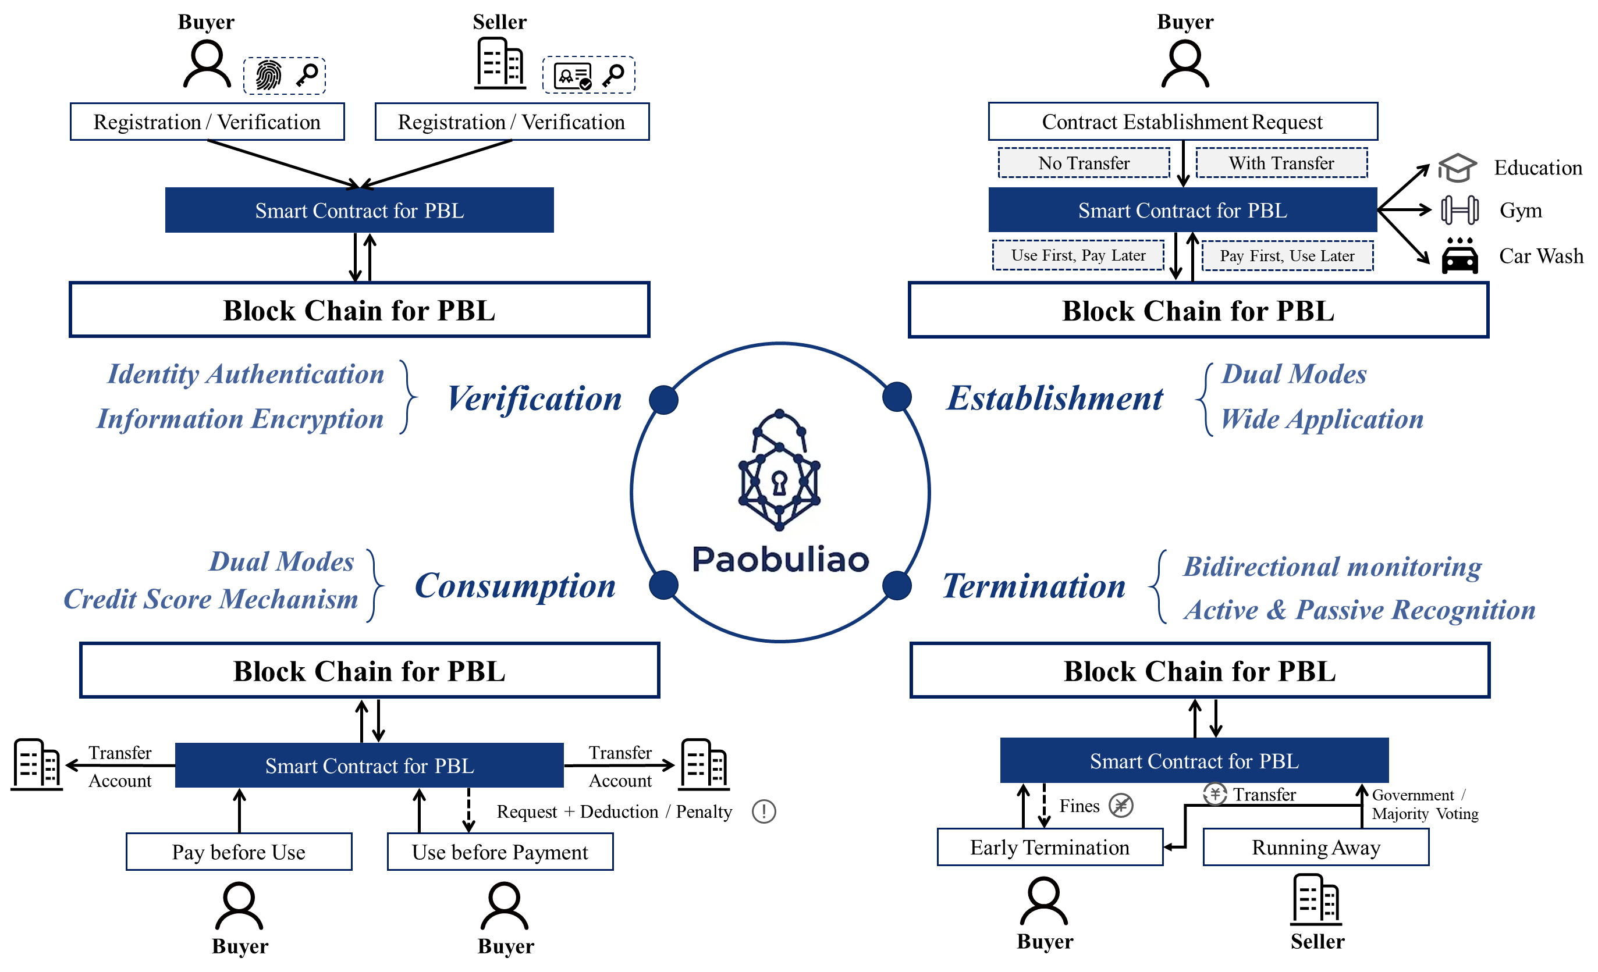
Ⅱ. Business Architecture
PaoBuLiao (PBL)
Your Online Transaction Solution.
01
2 Modes
Pay First, Use Later & Use First, Pay Later
02
4 Scenarios
Verification, Establishment,
Consumption, Termination
03
Security Guarantee
System Based on SC,
NO Losses Will Occur
System Details >>>
6
Notes:
This is a payment platform where buyer can either pay before enjoying service or enjoy service before paying.
The platform mainly covers 4 scenarios: buyer/seller verification, contract establishment, daily consumption, and contract termination.
The system is built on Smart Contracts, and we ensure that no losses will occur.
Maybe you cannot understand the structure fully yet, but don’t worry. I will explain it step by step.
Just keep one thing in mind: our goal is to treat buyers and sellers equally and protect interests of both parties.

Slide 7








Ⅱ. Business Architecture Analysis: Registration / Verification
Bioinformatics / Business Qualification Certification
PK Encryption and SK Authentication
Buyer Registration / Verification
Seller Registration / Verification
Buyer
Seller
Biological Information
Business Qualification
Encrypted Biological Information
Encrypted Business Qualification
Registration / Verification
Registration / Verification
Smart Contract for PBL
Smart Contract for PBL
Notes:
So the first step is Registration and Verification. For buyers, they need to encrypt their biological information to submit it to the Smart Contract. And for seller, business qualification is required.

Slide 8




Ⅱ. Business Architecture Analysis: Contract Establishment
Dual Modes: Use First, Pay Later & Pay First, Use Later
Credit Scoring Mechanism (Permission)
Contract Establishment
(Pay First, Use Later)
Contract Establishment
(Use First, Pay Later)
Buyer
Buyer
After Verification …
After Verification …
Contract Establishment Request
Contract Establishment Request
Transfer Money to Smart Contract
Credit Evaluation
Smart Contract for PBL
Smart Contract for PBL
Notes:
Then, before consumption, buyers need to establish contract with sellers. For Pay-First-Use-Later Mode, The buyer has to transfer money to Smart Contract after establishment request, while for Use-First-Pay-Later Mode, there is no transfer.

Slide 9






Ⅱ. Business Architecture Analysis: Daily Consumption (1/2)
Data Updated after Service Provided
Money Gradually Transferred from Buyer to Seller
Daily Consumption (Pay First & Use Later)
Scan the code before enjoying the service, with record sent to the SC
Buyer
After Verification …
Enjoy Service
Deduct Money from Buyer
Upload Service Usage Record
Transfer Money to Seller
Smart Contract for PBL
Notes:
After Establishment, buyer can use the system to do daily consumptions. For Pay-First-Use-Later Mode, after service, the smart contract deducts the buyer’s balance and transfer the payment to the seller according to the consumption record.

Slide 10



Ⅱ. Business Architecture Analysis: Daily Consumption (2/2)
Multiple options: Per-Use Card / Monthly / Annual Pass
Credit Scoring Mechanism (More Discount)
Daily Consumption (Use First & Pay Later)
Buyer
Deduct Credit Scores / Lawsuit
After Verification …
Insufficient Account Balance
Enjoy Service
Failed
Initiate Fine Deduction Request
Upload Service Usage Record
Successfully
Deduct Money from Buyer
Smart Contract for PBL
Periodically
Transfer Money to Seller
Notes:
And for Use-First-Pay-Later Mode, we introduced a credit scoring mechanism to tackle buyer defaults risks. If buyer does not have sufficient funds to cover the payment, his credit score will be deducted. This will impact both the discounts they can enjoy and their access to 'Use First, Pay Later' services.

Slide 11


Ⅱ. Business Architecture Analysis: Contract Termination (1/4)
Bidirectional monitoring: Buyer Side
Reclaim Discount and Give It Back
Buyer Terminates the Contract (Pay First & Use Later)
Buyer
After Verification …
Contract Termination Request
Impose Fines on Buyer
Smart Contract for PBL
Return Discount to Seller
Transfer Money Left to Buyer
Notes:
In terms of contract termination, there are four possibilities: the combination of 2 sides and 2 modes. If it is the buyer who terminated the contract under Pay-First-Use-Later Mode, because it’s a kind of buyer default, the discount buyer enjoyed will be reclaimed and returned to the seller.

Slide 12
Ⅱ. Business Architecture Analysis: Contract Termination (2/4)
Bidirectional monitoring: Buyer Side
Reclaim Discount and Give It Back
Buyer Terminates the Contract (Use First & Pay Later)
Buyer
Deduct Credit Scores / Lawsuit
After Verification …
Insufficient Account Balance
Contract Termination Request
Failed
Initiate Fine Deduction Request
Smart Contract for PBL
Successfully
Deduct Money from Buyer
Return Discount to Seller
Notes:
And For buyer side with Use-First-Pay-Later Mode, the handling of buyer default is the same as daily consumption.

Slide 13





Ⅱ. Business Architecture Analysis: Contract Termination (3/4)
Bidirectional monitoring: Seller Side
Active Recognition & Passive Recognition
Seller Breaches the Contract and Runs Away (Pay First & Use Later)
Buyers
Government
After Verification …
Buyers Report
Majority Voting
Verify Qualifications
Automatic Contract Termination
Smart Contract for PBL
Transfer Money Left to Buyer
Notes:
If sellers ran away, how to protect the interest of buyers. We have 2 methods: Active Recognition and Passive Recognition.
For active recognition, the smart contract will regularly verify the sellers’ qualifications. If the seller is found to have lost their qualifications, the contract will be terminated immediately.
In addition, for passive recognition, the smart contract allows buyers to report issues. If the number of reports exceeds a certain threshold, the contract will also be terminated.

Slide 14
Ⅱ. Business Architecture Analysis: Contract Termination (4/4)
Bidirectional monitoring: Seller Side
Active Recognition & Passive Recognition
Seller Breaches the Contract and Runs Away (Use First & Pay Later)
Buyers
Government
After Verification …
Buyers Report
Majority Voting
Verify Qualifications
Smart Contract for PBL
Automatic Contract Termination
Notes:
The difference between 2 modes are that for Pay-First-Use-Later Mode, the money will be returned to the buyers after termination.

Slide 15
Ⅱ. Business Architecture
PaoBuLiao (PBL)
Your Online Transaction Solution.
01
2 Modes
Pay First, Use Later & Use First, Pay Later
02
4 Scenarios
Verification, Establishment,
Consumption, Termination
03
Security Guarantee
System Based on SC,
NO Losses Will Occur
System Details >>>
15
Notes:
Let’s take a look at this overview again. In short, our smart contract-based transaction system covers four scenarios: verification, contract establishment, daily consumption, and contract termination. and it supports both pay-first-use-later and use-first-pay-later modes.
Within the system, credit risk is fully addressed. Under the pay-first-use-later mode, buyers no longer need to worry about losing money if a seller disappears after receiving payment. Meanwhile, sellers are also protected from buyers with poor credit attempting to take unfair advantage by use-first-pay-later mode. In this way, the interests of both parties are perfectly protected.
I believe you now have a preliminary understanding of our business architecture, and the subsequent technologies will be built upon it.

Slide 16
Technological
Implementation

Slide 17
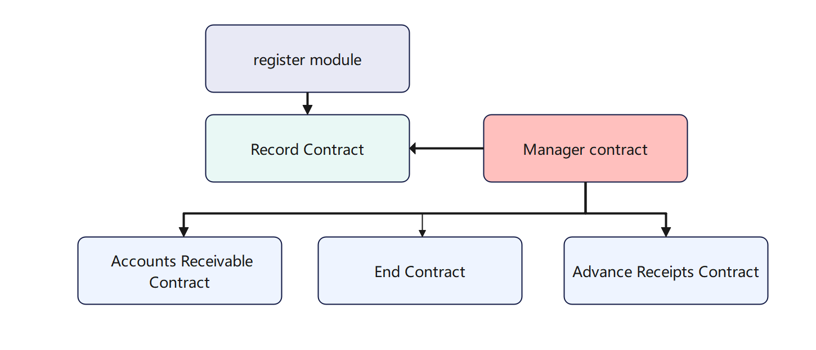

Ⅲ. Underlying Technical Logic
Login module (Login Module):
Responsible for user registration and writing to the Record Contract.
Record Contract (Record Contract):
Stores all user information, functioning like a database.
Manager Contract (Management Contract): Addresses misconduct and enforces penalties.
Accounts Receivable Contract (Pay-After-Use Contract):
Handles the logic of "use first, pay later."
Advance Receipts Contract (Pay-Before-Use Contract):
Manages the logic of "pay first, use later."
End Contract (Termination Contract):
Determines/terminates either the Pay-After-Use or Pay-Before-Use Contract.
Notes:
Let's first examine the technical module architecture.
Register Module
When users want to use the app, they register through this module
After registration, relevant information is written to the Record Contract
Record Contract
Functions like a database to store all user information
Contains both basic profile data and operational data for future transactions
Accounts Receivable Contract (Pay-After-Use Contract)
Handles all business logic for "use first, pay later" services
Advance Receipts Contract (Pay-Before-Use Contract)
Manages the operational logic for "pay first, use later" services
End Contract (Termination Contract)
Determines and executes termination of either pay-after-use or pay-before-use contracts
Activates when conditions are met (e.g., contract expiration or user-initiated termination)
Manager Contract
Proactively or reactively addresses misconduct and administers penalties

Slide 18

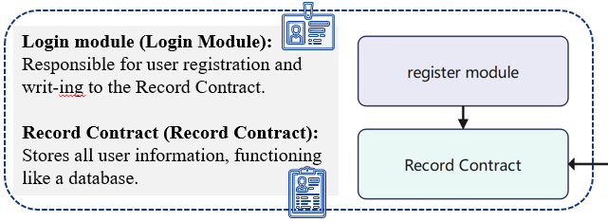
Ⅲ. Underlying Technical Logic: Identity Authentication/Registration
Identity Authentication
Establishment from Two Perspectives: Buyer Onboarding and Seller Onboarding
Buyers
Sellers
During registration, Buyers complete identity authentication and registration by providing biometric information (such as fingerprints, facial recognition, etc.) or generating a cryptographic key pair.
The smart contract stores the following information:
Sellers must provide qualification documents for registration and generate a key pair to ensure the credibility of the service provider's identity.
The smart contract stores the following information:
User ID
Encrypted identity hash
buyerPubKey
Merchant ID
Encrypted qualification hash
sellerPubKey
Contract
The Record contract stores all user/merchant information.
The contract defines two structs, BuyerInfo and SellerInfo, which are used to record the identity and transaction information of users and merchants, respectively. These structs support subsequent
payment and service logic invocations.
struct Buyerlnfo {
uint256 id;
bytes publicKey;
string name;
uint256 balance;
…
}
struct Sellerlnfo {
uint256 id;
bytes publicKey;
string name;
uint256 balance;
boolean status;
…
}
Notes:
Let me walk you through the identity authentication and registration process.
For users, the registration process allows them to complete identity verification through biometric inputs like fingerprints or facial recognition. The system will automatically generate cryptographic keys that will be used for future authentication.
For merchants, they need to provide relevant business credentials to demonstrate their legal operating status. The system will similarly generate cryptographic keys for them as well.
All this information is securely stored using smart contracts. The system maintains comprehensive records of both users' and merchants' basic information, including unique IDs, public keys, account balances and other essential data.
Within the contract, we've defined two key data structures - BuyerInfo and SellerInfo. These structures respectively store identity and transaction information for users and merchants, forming the foundation that supports all subsequent payment processing and service logic in our system.
The design ensures secure authentication while maintaining all necessary records for smooth transaction processing.

Slide 19

Ⅲ. Underlying Technical Logic: Payment Logic
Pay-After-Use Contract
consume(userId, amount)
Add amount to user's pendingDebt
payDebt(userId, amount)
Ensure user exists
Require amount <= pendingDebt
Deduct amount from pendingDebt
Add amount to sellerBalance
Pay-Before-Use Contract
deposit(userId, amount)
Deduct amount from user‘s balance
Add amount to buyer's balance
freeze balance
consume(userId, amount)
Ensure user exists
Require sufficient balance
Add amount to sellers
Pay-After-Use Contract
Pay-Before-Use Contract
Econsume
Paydebt
Functions include: Credit score adjustment for users
Deposit
Consume
Functions include: Credit score adjustment for users
Pay-After-Use Functionality
buyers can access services immediately
The contract records the user's "pending debt", which must be settled later via payDebt()
Pay-Before-Use Functionality
buyers must deposit funds first (prepaid amount locked in the smart contract)
Direct transfer to merchants upon consumption
Payment Logic
Notes:
For the use-before-pay, the system records the buyer's "amount payable" through the smart contract. After comsuming, the user must settle the payment by calling the payDebt() function.Specifically, the consume(userId, amount) function adds the specified amount to the buyer’s pendingDebt. Then, the payDebt(userId, amount) function handles the payment process: it first checks whether the payment amount is less than or equal to the pendingDebt, deducts the amount from the buyers’s pendingDebt, and finally adds the payment to the seller’s balance (sellerBalance).In the pay-before-use , the deposit(userId, amount) function deducts the buyer’s balance upfront and adds the amount to sellers balance while freezing the money to ensure they’re reserved for future consumption. Then, the consume(userId, amount) function，it firstly checks whether the frozen balance is sufficient; if it is, the amount is transferred to the seller.对于先用后付，系统通过合约记录用户的 “应付金额”。在使用完服务后，用户需要通过 payDebt () 这个操作来结清费用。具体来说，consume (userId, amount) 这个函数，它会把相应金额添加到用户的 pendingDebt（待还债务） 里。而 payDebt (userid, amount) 函数进行付款，首先会检查用户要支付的金额是否小于等于代付金额pendingDebt ；接着从 pendingDebt 中扣除相应金额，最后把这笔钱添加到卖家的余额 sellerBalance 里。使用先付后用时，deposit (userid, amount)先扣除买家余额，并会把相应金额添加到买家的余额里，同时冻结这笔资金，确保它专门用于后续的消费。而 consume (userid, amount) 函数，先检查冻结的余额是否充足，确认没问题后，再把这笔钱给到卖家。

Slide 20
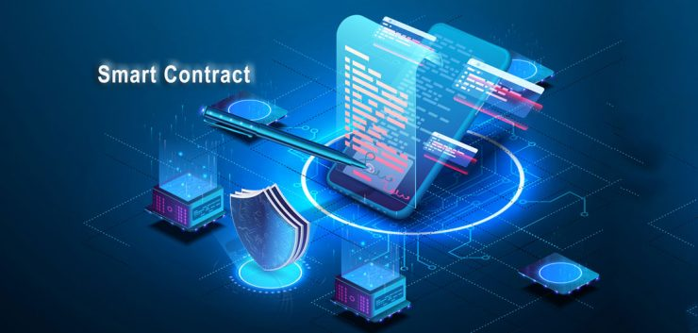
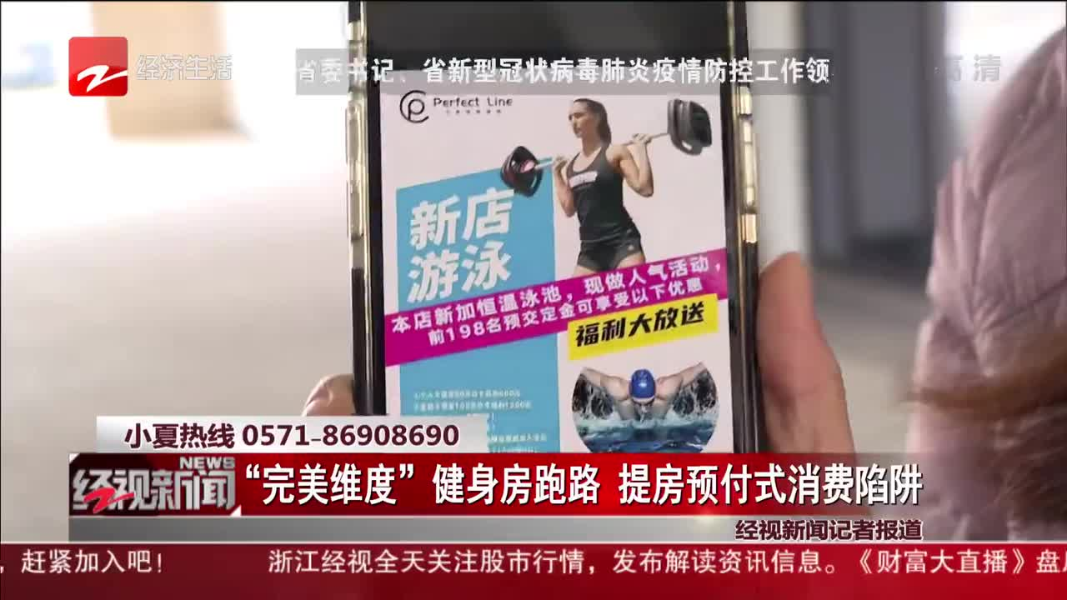
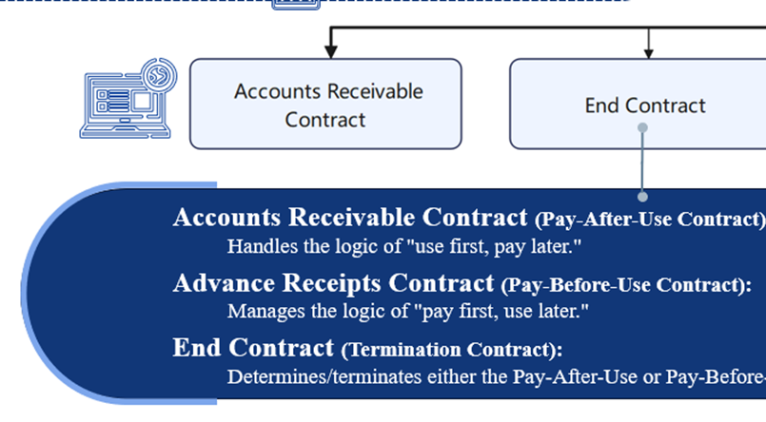
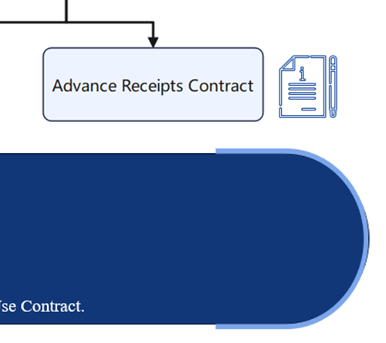
Ⅲ. Underlying Technical Logic: Credit Score & Termination Mechanism
Low Credit Score Consequences:
Service Suspension
The user/merchant's account privileges will be temporarily frozen
Platform Intervention
Automatic Arbitration
May involve third-party arbitrators for dispute resolution
Termination Mechanism
Credit Score
In both the Pay-After-Use and Pay-Before-Use contracts, we maintain credit scores (Credit Score) for both buyers and sellers.
For Buyers:
Must ensure their balance exceeds the pending debt (pendingDebt) by the repayment due date.
Late payments or defaults will result in credit score deductions.
For Sellers:
Receiving negative ratings will lead to credit score reductions.
User Contract Termination
Voluntary termination
Contract expiration
Seller
If a seller abandons operations ("runs away") or receives complaints exceeding 60%, the system will immediately invoke the Manager Contract, which will execute penalty mechanisms according to predefined rules.
Buyer
When voluntarily terminating a contract, users shall incur penalties if stipulated in the contract terms. The system will automatically invoke the Manager Contract, which will execute penalty mechanisms according to predefined rules.
Merchant Violations
Complaint rate ≥60%
Business abandonment ("Runaway")
Notes:
In both the use-before-pay and pay-before-use contracts, we maintain a credit score system for both buyers and sellers.For buyers, they must ensure their balance is greater than the pendingDebt (outstanding debt) by the repayment deadline. If they default or delay repayment, their credit score will be deducted. As for sellers, receiving negative reviews will also result in a reduction of their credit score.If the credit score drops too low, it may lead to account suspension or other serious consequences.Regarding the contract termination mechanism:For buyer: When the contract expires, it is automatically terminated. If the user terminates the contract early, the user will face corresponding consequences. In such cases, the system will automatically call the Manager contract, which will apply penalties based on predefined rules.For seller: If a merchant is found to have absconded, or if more than 60% of their transactions receive complaints, the system will immediately trigger the Manager contract. the Manager contract will enforce penalties according to preset rules.在先用后付和先付后用这两个合约中，我们都会对买家（buyer）和卖家（seller）维护信用评分（Credit score） 。对于买家来说，必须在还款日保证自己的余额大于 pendingDebt（待还债务） ，要是违约推迟还款，就会被扣信用分。而卖家呢，如果收到差评，同样也会导致信用分被扣减。信用分要是过低，会导致封号等结果在终止机制方面用户方面：合约到期了自动解除；如果用户主动解约，在合约条款存在相关规定的情况下，用户需要接受一定惩罚。这时，系统会自动调用 manager contract ，会依据预设规则对用户进行惩罚管理。商户方面：要是商户出现跑路行为，或者收到的投诉比例大于 60% ，系统会立即调用 manager contract 。同样，管理合约会按照预先设定好的规则，对违规商户执行惩罚机制。

Slide 21
Ⅲ. Underlying Technical Logic: Manager contract
Chinese pseudocode
checkStatus(userIds, sellerIds):
对每个 userId:
如果 用户信用分 < creditThreshold:
标记为黑名单用户
对每个 sellerId:
如果 商家信用分 < creditThreshold:
标记商家为非活跃
如果 资质已过期:
注销商家
如果 资质30天内过期:
触发资质即将过期提醒事件
Active Check Mechanism
(checkStatus() Scheduled Call)
Verify if user/merchant credit scores fall below threshold → Execute penalties
Monitor merchant certification expiration → Trigger alerts or deactivation
checkStatus(userIds, sellerIds):
for userId in userIds:
if user.creditScore < CREDIT_THRESHOLD:
flag_as_blacklisted(userId)
for sellerId in sellerIds:
if merchant.creditScore < CREDIT_THRESHOLD:
mark_as_inactive(sellerId)
if certification.is_expired():
revoke_license(sellerId)
if certification.expires_in(30 days):
trigger_alert("Certification Expiring Soon", sellerId)
Chinese pseudocode
Passive Trigger Mechanism
(Event-Driven)
Handle Merchant Abandonment:Mark merchants as inactive upon predefined triggers
Resolve Excessive Complaints:Process user complaint thresholds
reportSellerInactive(sellerId):
标记商家为非活跃
触发“商家跑路”事件
reportComplaint(sellerId):
商家投诉数 +1
如果 投诉数 ≥ maxComplaints:
标记商家为非活跃
触发“商家停用”事件
reportSellerInactive(sellerId):
mark_as_inactive(sellerId)
emit_event("Merchant Abandonment", sellerId)
reportComplaint(sellerId)
merchant.complaint_count += 1
if merchant.complaint_count >= MAX_COMPLAINTS:
mark_as_inactive(sellerId)
emit_event("Merchant Suspension", sellerId)
Notes:
The Manager contract is responsible for monitoring violations by buyer and seller, and enforcing corresponding penalties.First, it includes an active checking mechanism: it periodically calls checkStatus to monitor the credit scores of both users and merchants. If it detects that a user or seller’s credit score falls below the predefined creditThreshold, it will immediately enforce penalties. It also checks whether a sellers qualifications are about to expire or have already expired. If any issues are found, it triggers a timely alert, and if the qualifications have expired, the seller will be deactivated.Second, there is a passive trigger mechanism. Every time a complaint is filed against a seller, the seller’s complaint count increases by 1. If the number of complaints reaches or exceeds maxComplaints (the preset complaint threshold), the seller will be marked as inactive, and a “Merchant Deactivated” event will be triggered.In extreme cases, such as when a seller disappears (i.e., absconds), the seller will also be marked as inactive, and a “Merchant Absconded” event will be triggered.Manager contract会管理用户和商家的违规行为，进行相应惩罚。首先是主动检查机制：它会定期调用checkStatus检查用户和商家的信用分情况。一旦发现用户或者商家的信用分低于预先设定的 creditThreshold（信用分阈值） ，就会立即对其执行惩罚措施。它还会检查商家资质是否快要过期或者已经过期。如果发现商家资质存在问题，会及时触发提醒，要是过期了还会进行注销处理。其次是被动触发机制，每收到一次对商家的投诉，商家的投诉计数就会加 1 。要是投诉数达到或者超过了 maxComplaints（预设的最大投诉数） ，就会将商家标记为非活跃，并触发 “商家停用” 事件。当出现商家跑路这种情况时，将商家标记为非活跃，并触发 “商家跑路” 事件。

Slide 22
Conclusion & Extension

Slide 23

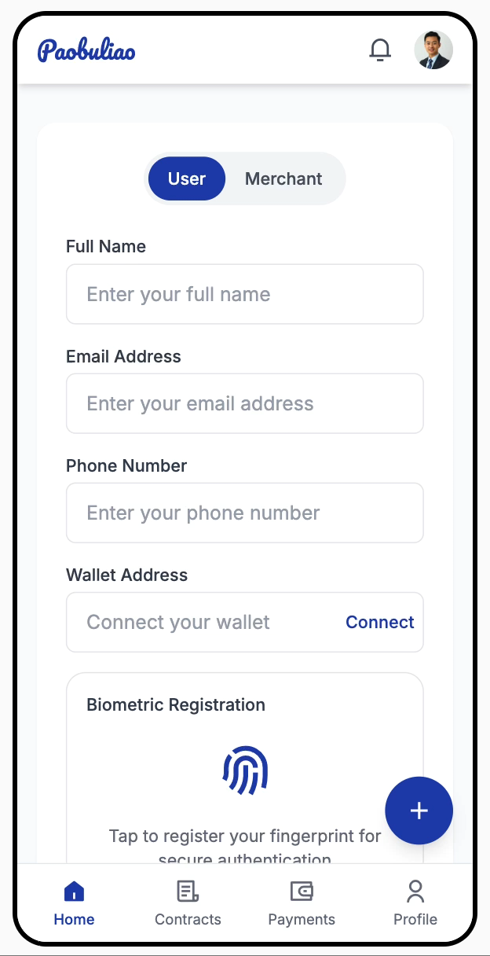
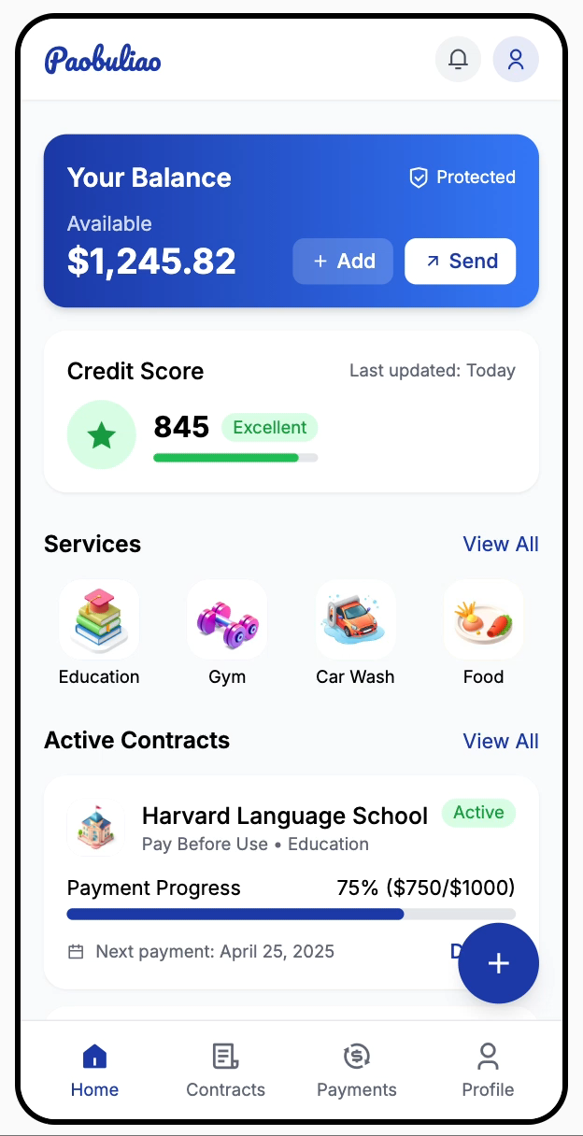
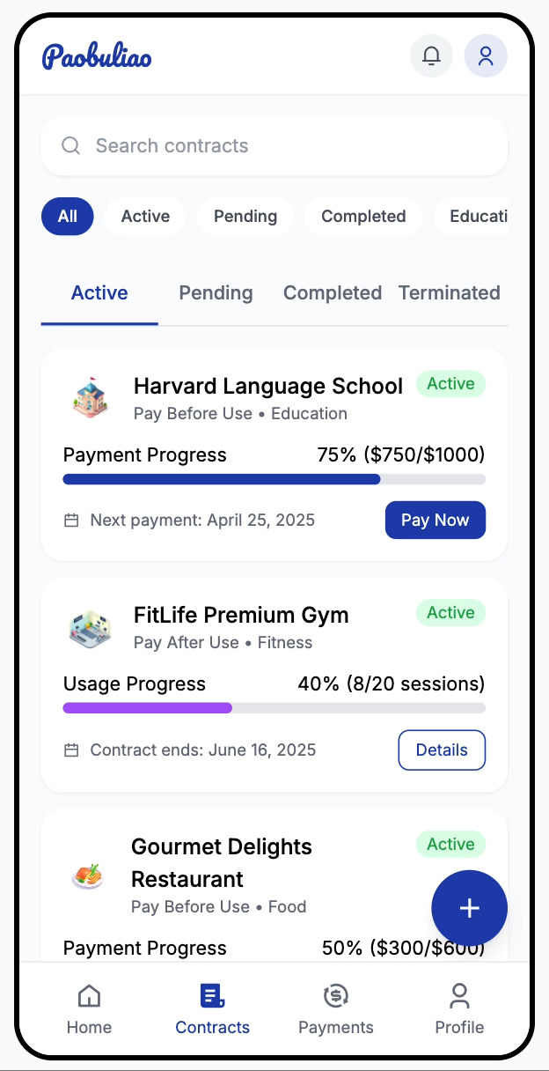
Paobuliao
- Train Better, Pay Safer -
IV. Function Demo
Registration
Home page
Contract

Slide 24


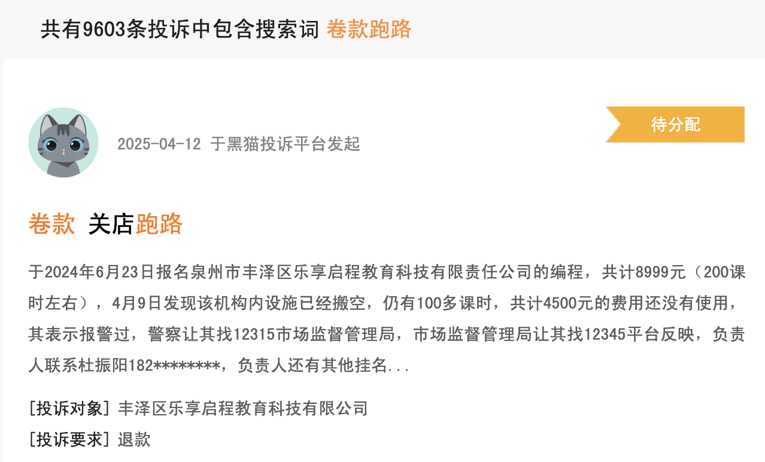
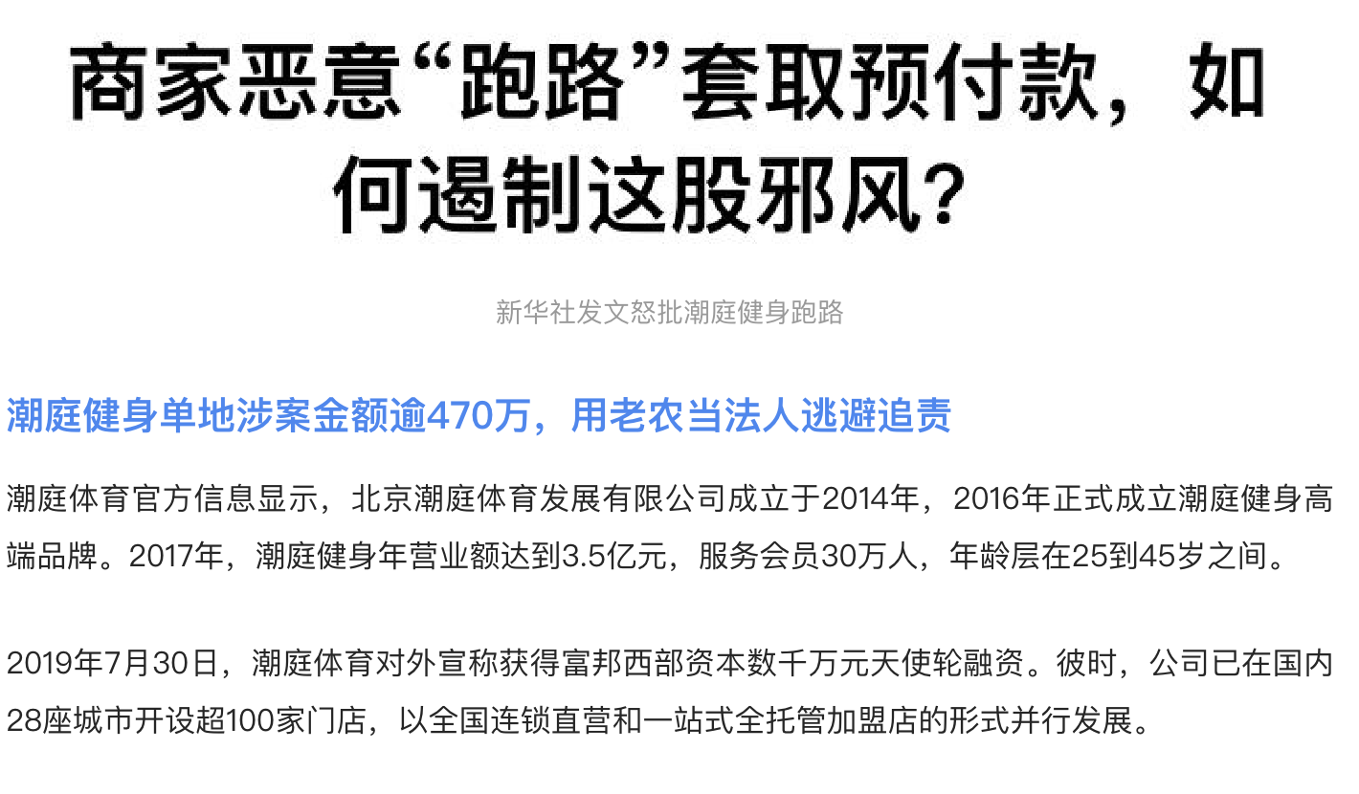
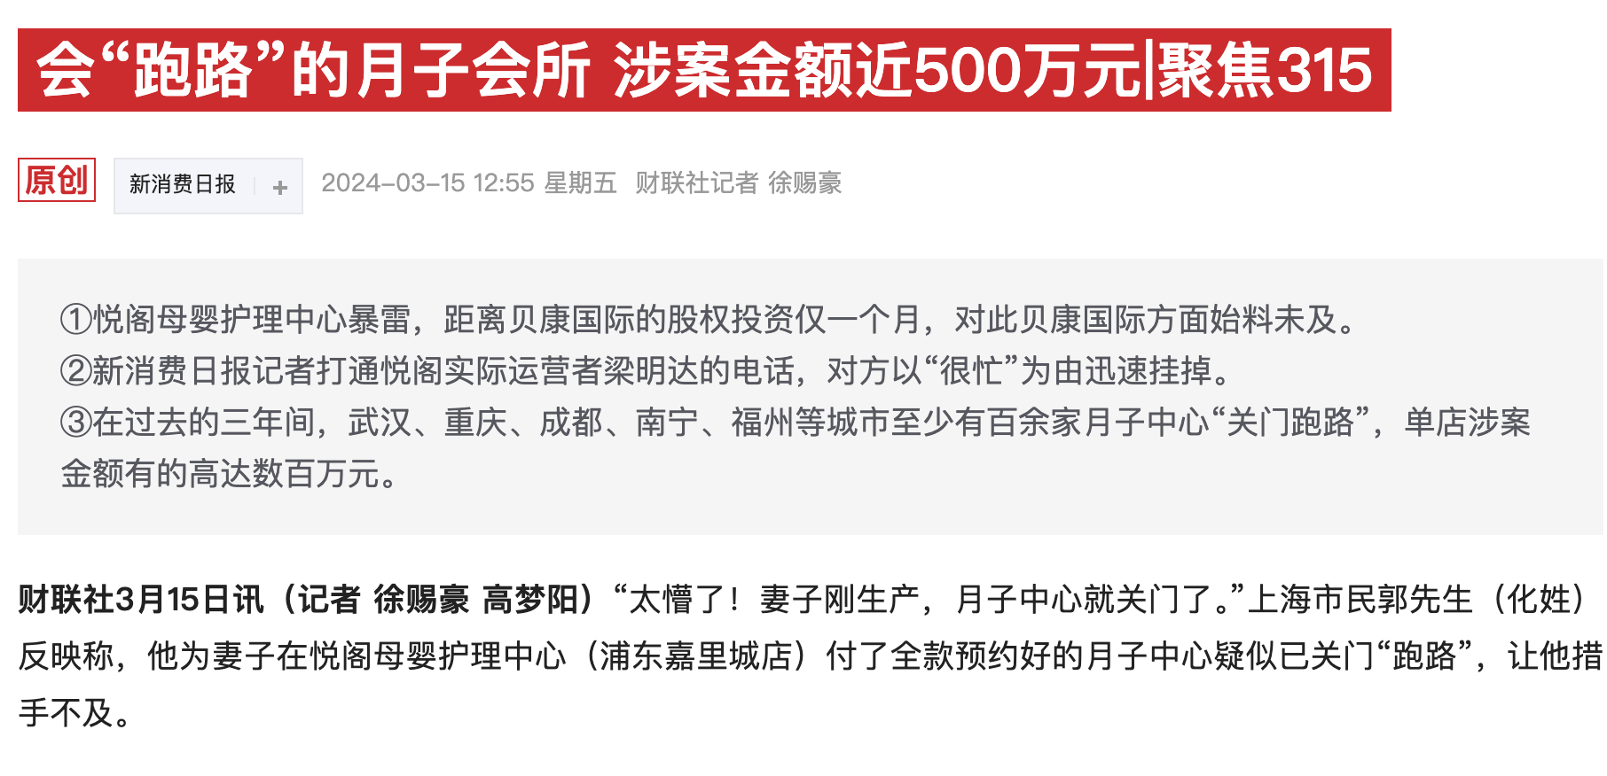
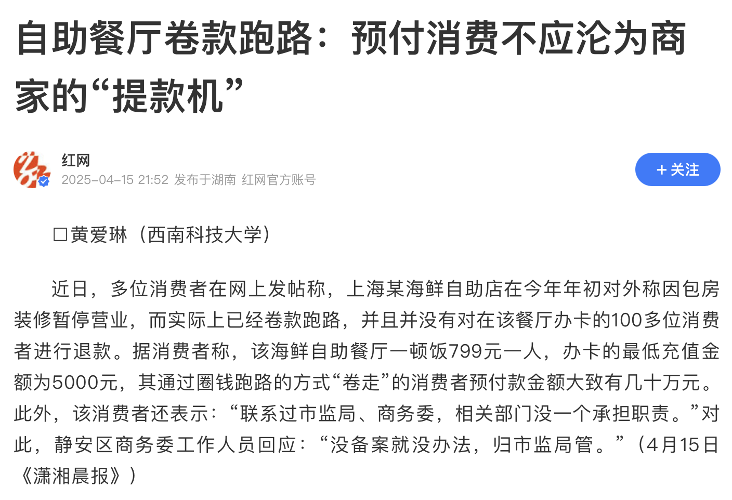
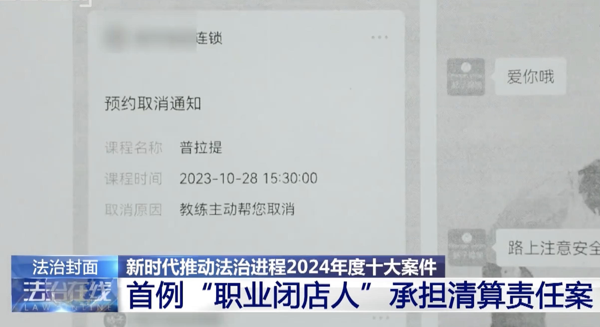
IV. Prepaid Chaos is Everywhere — Trust is Broken
The Number of Prepaid Complaint Issues in Chaoyang
From Users' Perspective | From Merchants' Perspective
✘ Prepaid gyms shut down overnight — money gone | ✘ Users default on payments after using the service
✘ Education providers go bankrupt — no refund | ✘ Merchants cover upfront costs but can’t recover losses
✘ Lack of effective legal protection | ✘ Long, costly dispute resolution process
69734
64932
25379
18294
8372
2020
2021
2022
2023
2024
The Collapse of Prepaid Trust:
3-Fold Increase in Consumer Complaints
Data Source: Chaoyang Distrct Procuratorate

Slide 25







IV. Redefining Trust in Transactions
Key Technologies
Secure Identity via Biometrics
+
Asymmetric Encryption
Dual Contract Modes
–
Pay Before / Pay After
On-chain Reputation
&
Penalty System
Use First, Pay Later
Pay First, Use Later
Fines
Government /
Majority Voting
Prevents Identity Fraud
Flexible For Users & Services
Transparent Rules & Risk control
Complies With KYC/AML Regulations
Covers Diverse Industries
Automated Enforcement
User-defined Trust-based Entry
Real Accountability
Secure Key Management
Smart-contract Based
Smart-contract Governs
No Fake User Sign-ups
No Platform Bias Toward A Single Flow
No Delayed or Biased Penalty Decision
Registration / Verification
Consumption / Establishment
Termination

Slide 26









IV. Purpose & Impact · Who Benefits?
Customer Confidence
Peace of mind
Financial Risk
Long-term Trust
Lower trial barriers
Brand Reputation
Merchants
User
Repeat Customers
Better service terms
This Isn’t Just an App
“It’s a New Way to reBuild Trust”
Society
Fair Market
Local Service
Legal Cost
Notes:
Fairer, more efficient service ecosystems
Promotes blockchain use in local service industries
Reduces legal costs and eases burden on regulators
Improved customer confidence
Lower financial risk
Long-term trust
Better brand & repeat customers
Peace of mind when paying in advance
Lower trial barriers
Better service terms

Slide 27
THANK YOU
18th April, 2025
Group Members: Kai Ren, YiMing Jiang, WeiJie Zhang, Rui Hu, Yang Lan
Notes:
Thank YOU

